Slide 2
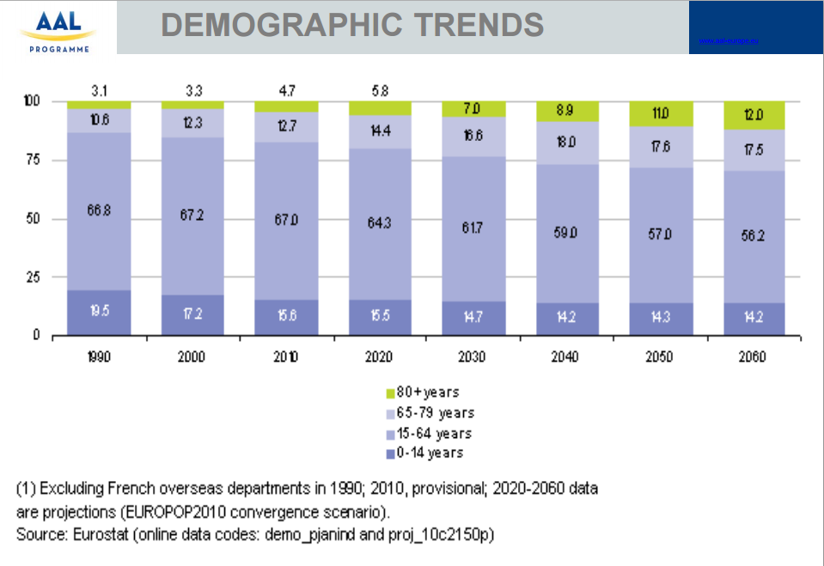
Demography of Ageing People

Slide 3
Societal Challenges of Ageing People
Worldwide population is aging (by 2050 over 20% of the population will be aged 65 or over )
Uneven demo-graphic composition.
Increase in age related illness.
It places additional burdens on healthcare provision.
The amount of informal support available will decrease due to a reduction in the ratio of working age people (15-64) to those older than 65.

Slide 4
Ageing People
Living actively and independently at home
Most older adults prefer to remain in the home of their choice as long as possible
Older adults face challenges related to coping with daily life activities and making decisions when they live independently, especially when living alone.

Slide 5
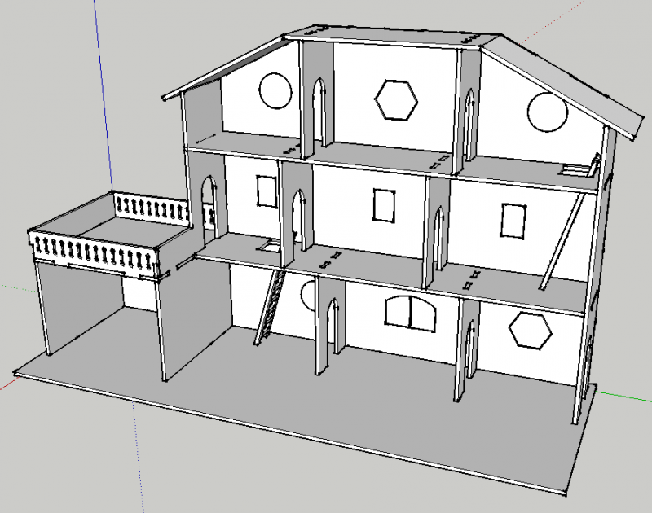
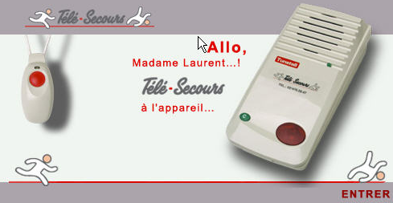
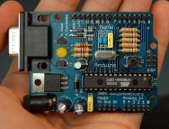
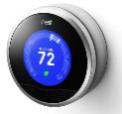
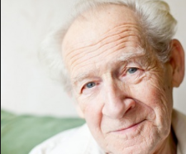

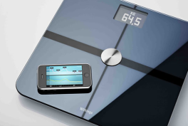
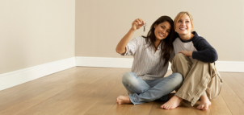
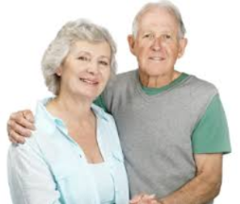
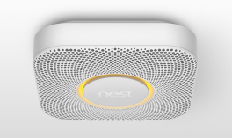
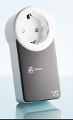
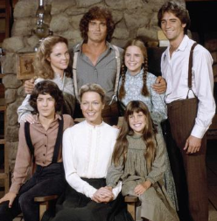
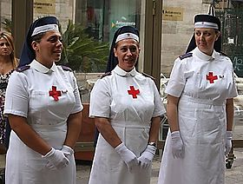
Internet of Things in Smarthome Context
What happen if I fall and become unconscious?
What happens if I do not hear a sound of phone ringing?
What happens if I forget to close the door?

Slide 6
Agenda

Slide 7
Challenges

Slide 8
General Framework

Slide 9
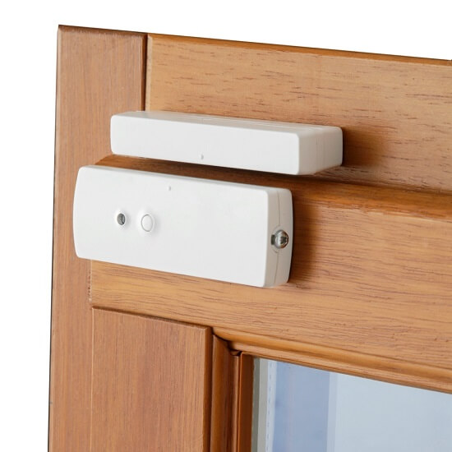

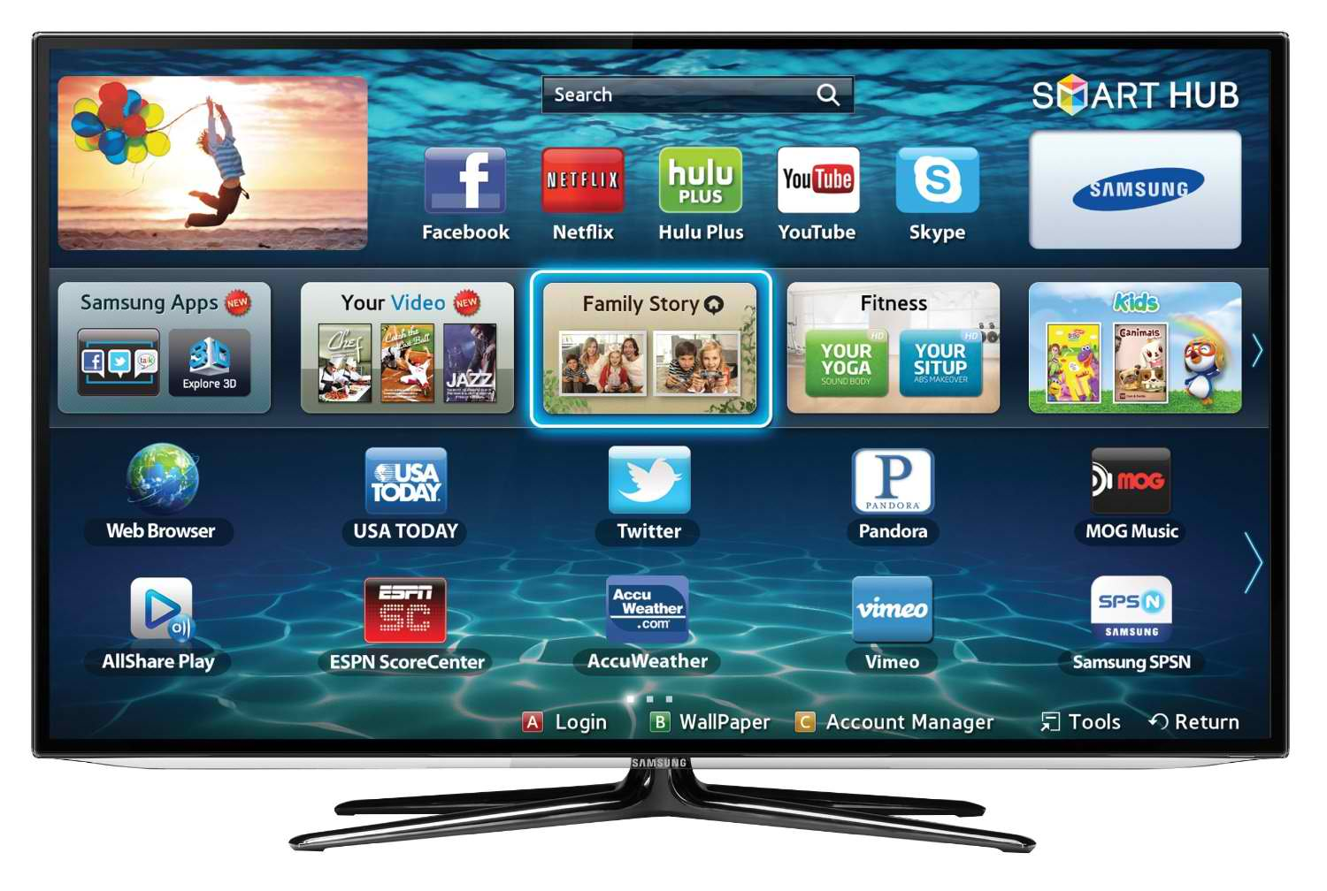
General Framework
Complexité
Interopérabilité
Sécurité
privacy
Confiance
User profile
Devices Type Declaration
Goal
Device profile
Context model
Network Configuration
Environement
Business Rules
Data
Data
Data
Command
Command
Command
Door sensor
Light actuator
Smart TV

Slide 10
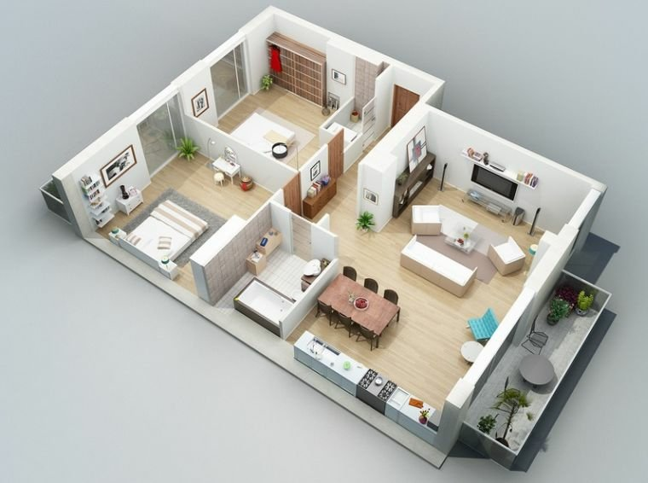
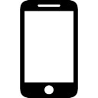
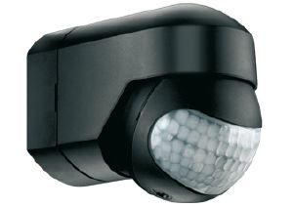
Usa Case
Détecteur de porte
Lampe
Smart TV
Téléphone
Détecteur de corps

Slide 11
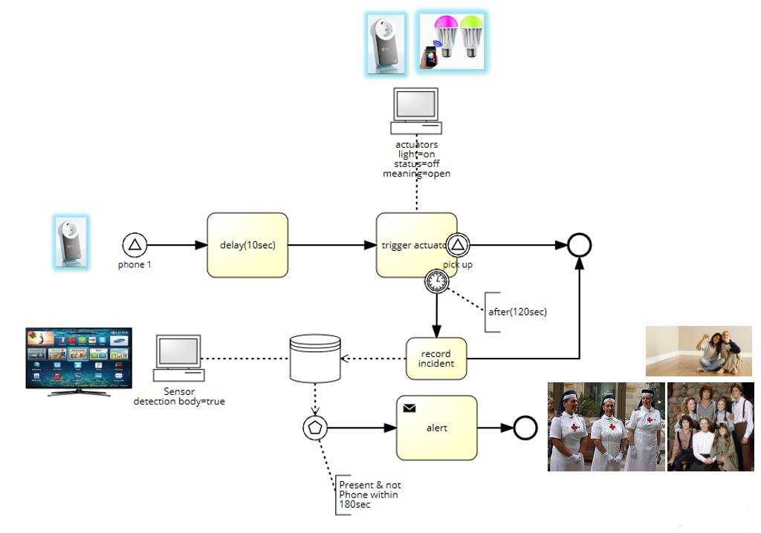
Use case

Slide 12
OUR DSL
Devices Type Declaration
Network Configuration
Business Rules

Slide 13
Devices Type Declaration
enumeration Volume {V1; V2; V3;}
device Phone{
sensing receiveCall()
actuating ring(volume:Volume)
actuating setVolume(volume: Volume)
sensing pickedUp()
}
device LightBulb{
actuating on()
actuating off()
actuating blink()
}
device Timer{
actuating reset()
actuating set(delay : Volume)
sensing timeout()
}
device AlertDB{
actuating declareIncident(msg:string)
actuating alert()
}
device BodyDetector{
sensing detect()
actuating isPresent()
}
gateway Central

Slide 14
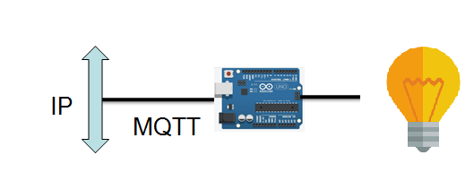
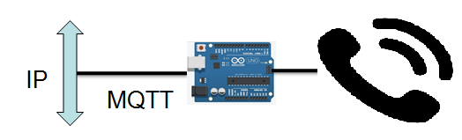
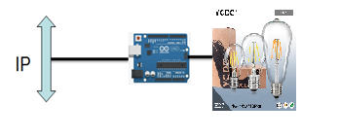
Network Configuration
configuration MyHome{
node gw : Central
node entranceBulb : LightBulb
node bathroomBulb : LightBulb
node kitchenBulb : LightBulb
node roomBulb : LightBulb
node ipPhone : Phone
node db : AlertDB
node bodydetector : BodyDetector
node timer : Timer
from entranceBulb to gw via MQTT
from bathroomBulb to gw via DDS
from kitchenBulb to gw via DDS
from roomBulb to gw via MQTT
from ipPhone to gw via MQTT
}
RoomBulb
IpPhone
KitchenBulb
DDS

Slide 15
Business Rules
rule WaitBeforeBlink :
when (ipPhone.ring()) do {
timer.reset()} ; timer.set(10)
}
rule BlinkAndWait:
when (timer.timeout()) do {
LightBulb.blink()
||
(timer.reset() ; timer.set(120))
}
rule PickedUpQuick:
when (ipPhone.pickedUp()) do{
LightBulb.off()
}
rule NotPickedUpAfterBlinking:
when (timer.timeout()) do{
db.declareIncident(predefinedAlert)
||
bodydetector.detect()
||
timer.reset() ; timer.set(60)
}
rule Alert:
when (timer.timeout() and bodydetector.present()) do {
db.alert()
}

